Slide 1



a00s3e3 - DONE
F= -1.77969
F = -1.77893
F= -1.77588, unstable

Slide 2










a00s5e3 - DONE
F = -2.986
F = -2.98574
F = -2.98733
F = -2.98580
F = -2.98637
F = -2.98644

Slide 3


a00s6e3 - DONE
F = -3.59170
F = -3.59404

Slide 4


a00s7e3 - DONE
F = -4.20090
F = -4.20224
Terran tried stripe (15.2, 20.2) & (12.2, 20.2). Unstable

Slide 5



a05s3e3 - DONE
F = -1.77283
F = -1.77232
F = -1.77005

Slide 6



a05s5e3 - DONE
F = -2.97229
F = -2.97422
F = -2.97365

Slide 7



a05s6e3 - TERRAN
F = -3.57664
F = -3.57732
F = -3.57783

Slide 8



a05s7e3 - DONE
F = -4.18090
F = -4.18116
F = -4.18226

Slide 9
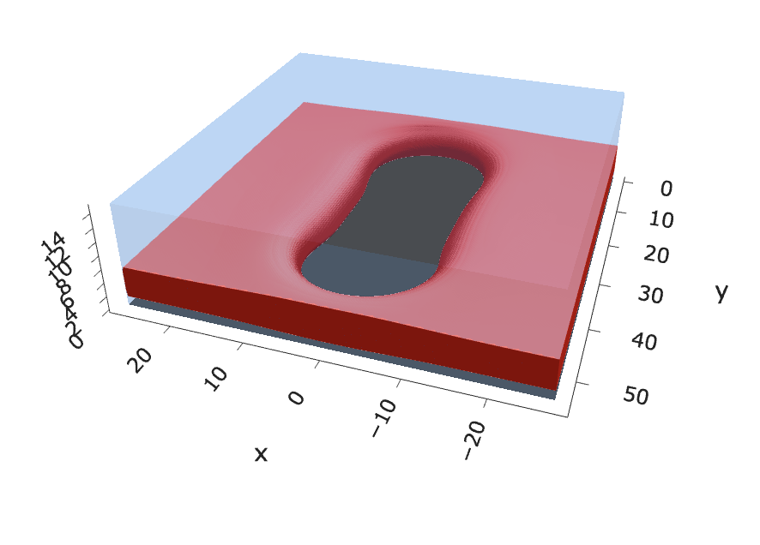
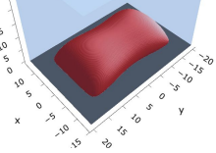
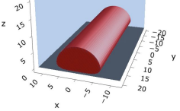
a10s2.5e3 - JOSH
F = -1.45857
F = -1.45840
F = -1.45357

Slide 10
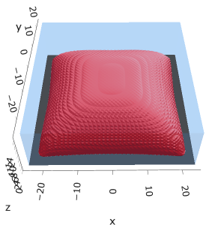


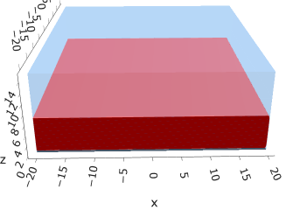


a10s5e3
F = -2.93742
F = -2.93851
F = -2.93859
F = -2.93848

Slide 11


a10s0075
F = -4.42442
F = -4.42466

Slide 12


a10s010 - DONE
F = -5.90899
F = -5.90938
Josh tried hole. Unstable

Slide 13
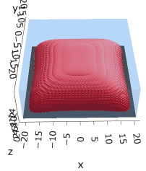



a15s5e3 - TERRAN
F = -2.88508
F = -2.88591
F = -2.88482
F = -2.88653

Slide 14
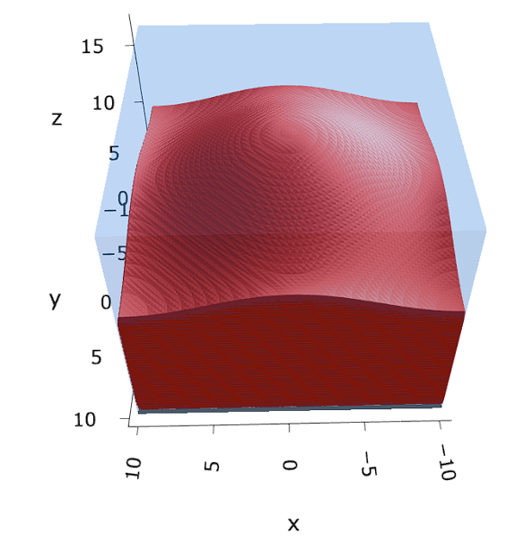

a15s1e2 - TERRAN
F = -5.78462
F = -5.78568
F = -5.78574

Slide 15

a20s5e3
F = -2.82020
No hol mic?

Slide 16
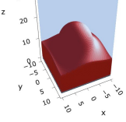
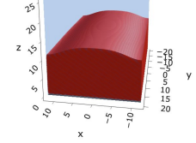
a20s010
F = -5.63481
F = -5.63514

Slide 17


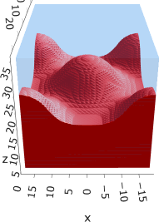
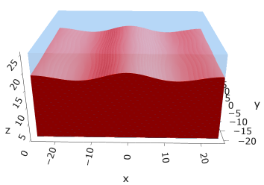
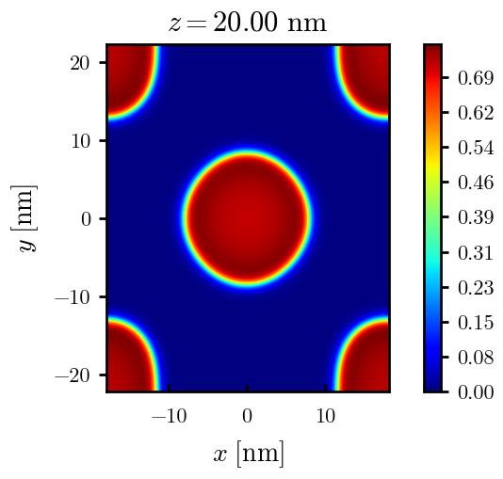
a20s015
F = -8.44011
F = -8.44081
F = -8.43935
F = -8.43930
n_coarse = 2

Slide 18



a20s0175
F = -9.83777
F = -9.83863
F = -9.83859

Slide 19




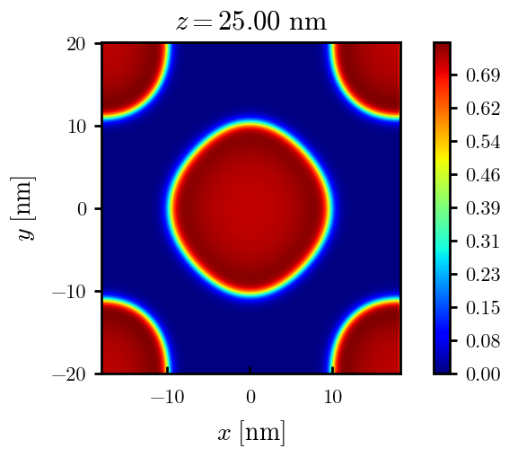
a20s020
F = -11.2312
F = -11.2319
F = -11.2321
n_coarse = 2

Slide 20



a20s022 – DONE
F = -12.3420
F = -12.3429
F = -12.3433

Slide 21




a20s025 - DONE
F = -14.0028
F = -14.0029
F = -14.0033
F = -13.9755

Slide 22




a20s027 - DONE
F = -15.1049
F = -15.1047
F = -15.0898
F = -15.1050

Slide 23
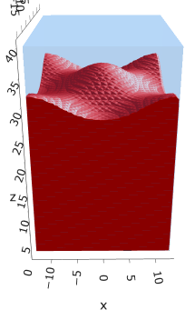
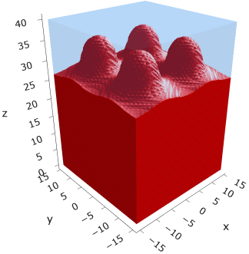
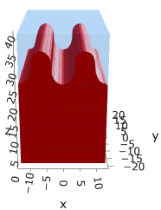
a225s025
F = -13.7769
F = -13.7774
F = -13.7775

Slide 24
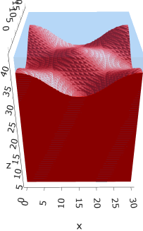
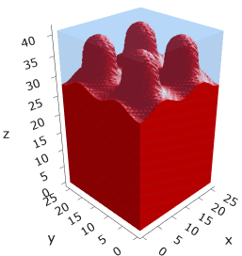
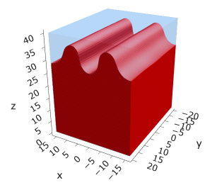
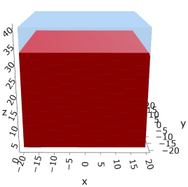
a225s0275
F = -15.1288
F = -15.1293
F = -15.1292
F = -15.1293

Slide 25
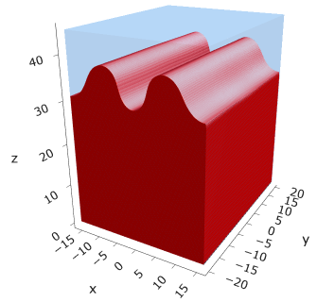
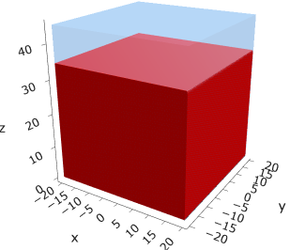
a225s030
F = -16.4742
F = -16.4743

Slide 26
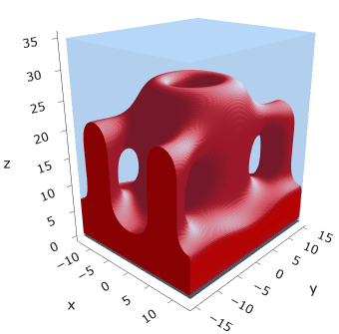
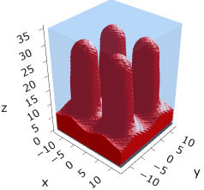
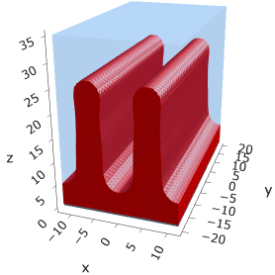
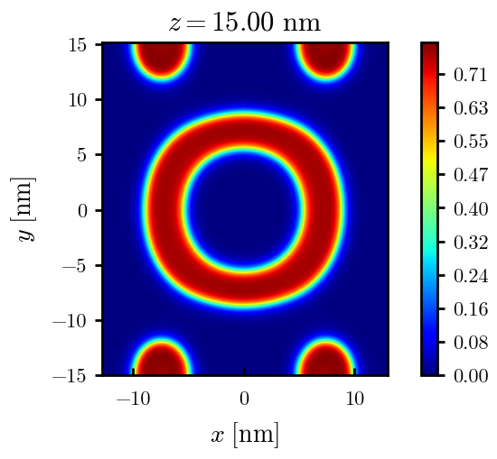
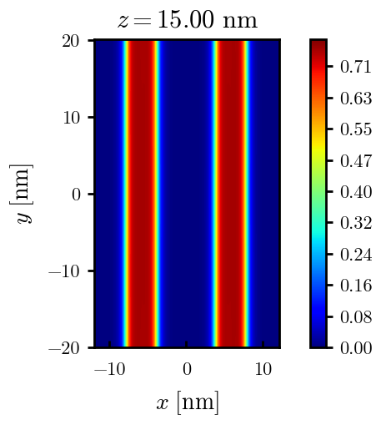
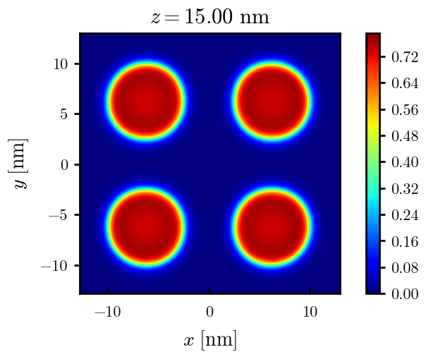
a25s010
F = -10.8712
F = -5.48250
F = -5.48457

Slide 27
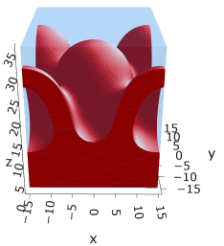
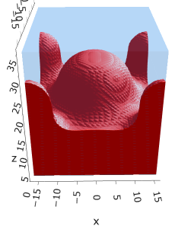
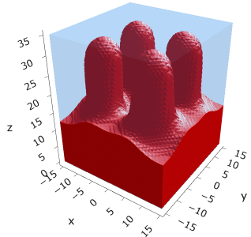
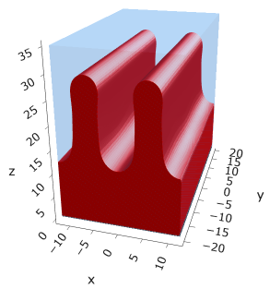

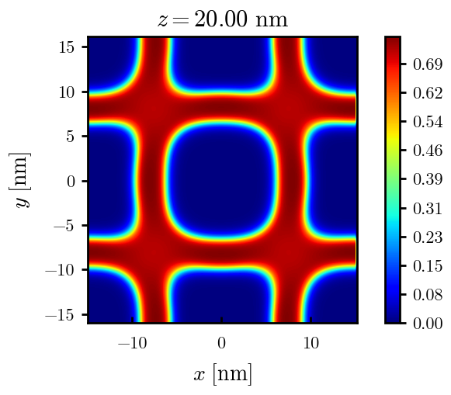
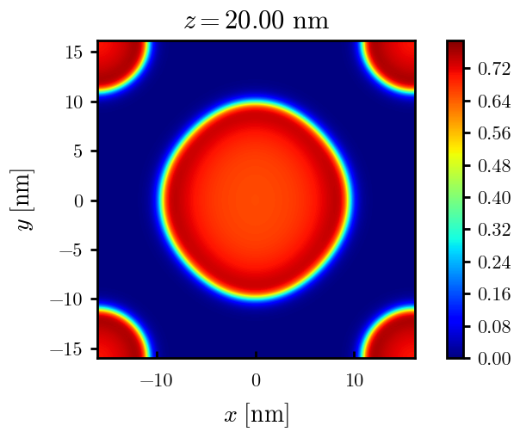
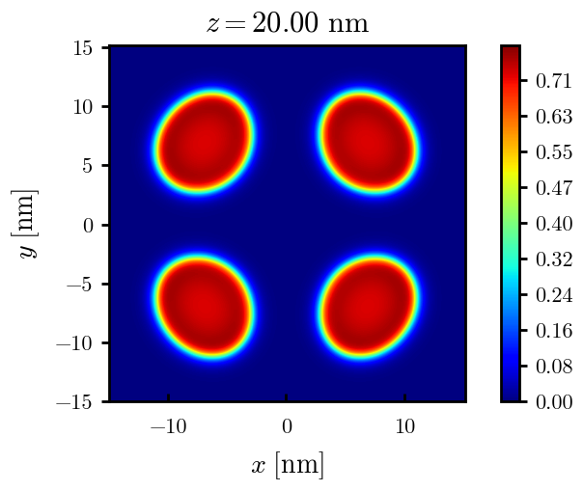
a25s015
F = -8.18187
F = -8.17785
F = -8.18512
F = -8.18755

Slide 28
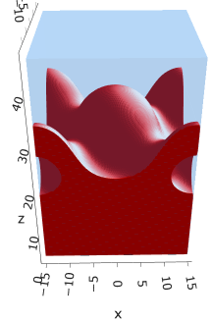
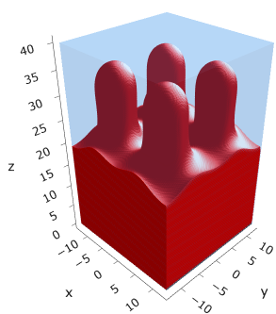
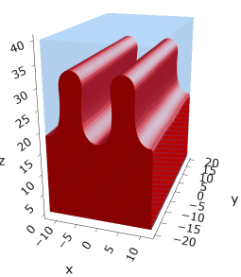
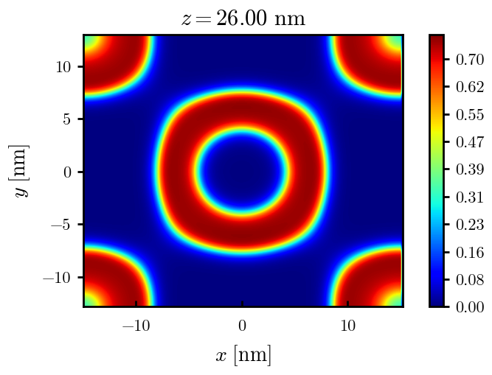
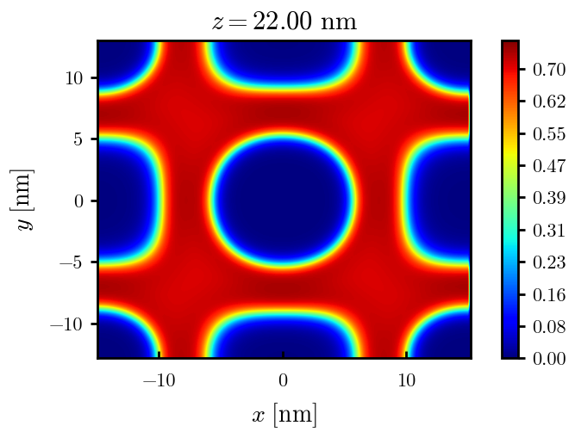
a25s020
F = -10.8712
F = -10.8748
F = -10.8766

Slide 29
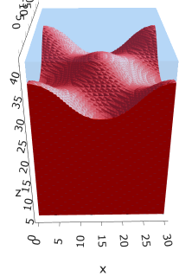
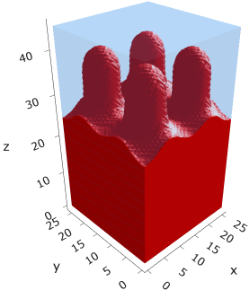
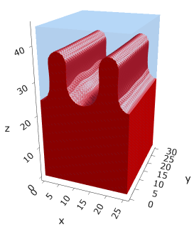
a25s025
F = -13.5406
F = -13.5450
F = -13.5461

Slide 30
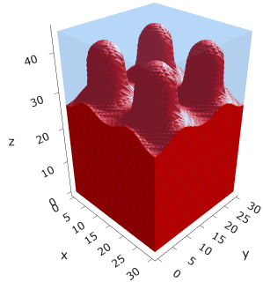
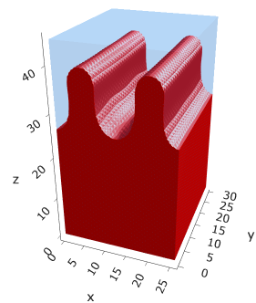
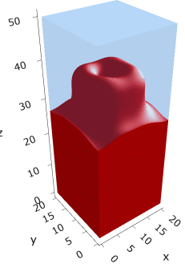



a25s027
F = -14.6059
F = -14.6065
F = -14.6030
F = -14.6015
F = -14.6022
F = -14.6018

Slide 31

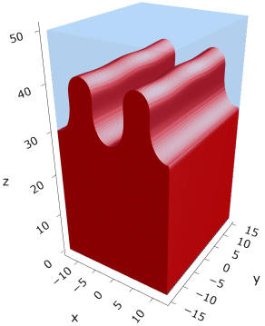




a25s030
F = -16.1888
F = -16.1892
F = -16.1854
F = -16.1854
F = -16.1858
F = -16.1857

Slide 32
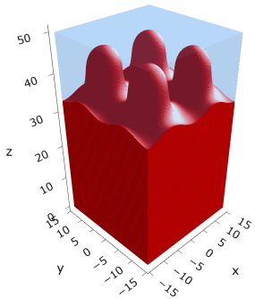
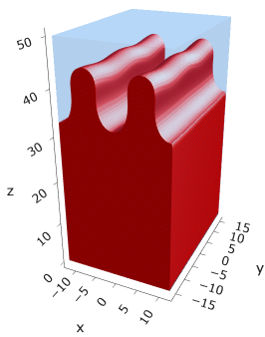




a25s0325
F = -17.4997
F = -17.4998
F = -17.4968
F = -17.4973
F = -17.4971
F = -17.4975

Slide 33
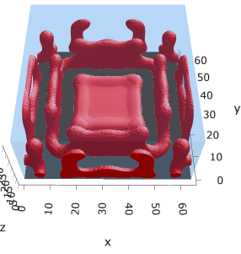

a30s0025
F = -2.69014

Slide 34


a30s005

Slide 35

a30s015

Slide 36









a30s020
F = -10.5092
F = -10.5098
F = -10.4996
F = -10.4878
F = -10.4764

Slide 37





a30s025
F = -13.0657
F = -13.0668
F = -13.0548
F = -13.0538
F = -13.0394

Slide 38






a30s030
F = -15.5953
F = -15.5956
F = -15.5886
F = -15.5897
F = -15.5739

Slide 39





a30s0325
F = -16.8494
F = -16.8486
F = -16.8312
F = -16.8491
F = -16.8268
2C isomin = 0.5

Slide 40






a30s035
F = -18.0779
F = -18.0943
F = -18.0948
F = -18.0946
F = -18.0887
F = -18.0782

Slide 41









a30s040
dz =0.15
F = -20.5583
F = -20.5585
F = -20.5582
F = -20.5549
F = -20.5390
F = -20.5384

Slide 42







a30s045
n_coarse = 2
dz =0.15
F = -22.9834
F = -22.9822
F = -22.9788
F = -22.9692
F = -22.9716

Slide 43





a30s050
dz =0.15
F = -25.3647
F = -25.3647
F = -25.3619
F = -25.3553
F = -25.3480

Slide 44




a30s055
F = -27.6992
F = -27.6993
F = -27.6917
n_coarse = 3

Slide 46




a30s020, chi = 1.35
F = -10.3763
F = -10.3644
F = -10.3602
F = -10.3437

Slide 47





a30s040, chi = 1.35
F = -20.3489
F = -20.3492
F = -20.3446
F = -20.3275
F = -20.3219

Slide 48


a325s020
F = -10.2994
F = -10.2821

Slide 49




a35s020
Cyl?
3 “layers”
+1 dilute layer < isomin = 0.1

Slide 50





a35
s10
s12
s15
s18

Slide 51



Parallelization
$$α=0, χ=1.25, N=50, σ=0.02$$
$$α=0, χ=1.25, N=200, σ=0.005$$
$$L_{x}=L_{y}=23, { L}_{z}=15$$
Nth = 12: 500 it, 4.3 hrs
Nth = 8 : 500 it, 6.9 hrs
Nth = 6 : 415 it, 20 hrs (poss. mem bottleneck)

Slide 52







Exercise: Micelle / Stripe
s = 5e-03, N = 50, a = 0.0, x = 1.0
s = 5e-03, N = 75, a = 0.0, x = 1.0
Isosurface at pha = 0.1

Slide 53






a040x170s020

Slide 54






a040x170s010

Slide 55

a040x170s025

Slide 56














a040x170s022

Slide 57










a040x170 seed
See if becomes hex
cyl4-975
cyl4-12
cyl16-975
cyl16-1025
cyl1

Slide 58






a040x170s017

Slide 59












































a040x170s015 seed
Almost done
Almost done

Slide 60

















a040x170s013

Slide 61
















a040x170s010 seed

Slide 62














X200 x170 x130 x120 x100
F = −10.24458
F = − 9.14301
F = −11.0057
F = −10.2429
F = −11.0015
F = −9.63949
F = −10.2461
F = −10.9948
F = − 9.63030
F = −10.2431
F = −10.9953

Slide 63





a040x100 relaxation

Slide 64








































a040x100 seed
old
old

Slide 65


a040x120 relaxation
F = −10.24458

Slide 66





































a040x120 seed
cyl16-850
cyl16-825

Slide 67






a040x130 relaxation

Slide 68




a040x170 relaxation
F = −9.10347
1 neck

Slide 69







a040x200 relaxation

Slide 70










a040x200 seed
Note: not completely converged but stopped for resources

Slide 72


a0.40 x1.70

Slide 73





Zhulina JCP 1998
a = 0.01
0.1 mM
1 mM
May need to init using sine
10 mM
25 mM
Zhulina NVT; current GCE runs at Lz = 20

Slide 74

Carrillo Langmuir 2009

Slide 75

Parallelization

Slide 76
Equations
Quenched average, np, A --> \inf ; np/A → \sigma
Discrete Gaussian chain

Slide 77




Scaling (Alexander—de Gennes brush)
V = 4.2; H = 27.5 – 30.5
V = 2; H = 39 – 45.5

Slide 78







$φ_{p}$: DGC (3D; NxNy=1) vs MDE (1D)
Ns/sigs: dz = 0.10, Ngz_2 = 4$σ$; Chis/bs: dz = 0.25, Ngz_2 = 3.5$σ$

Slide 79


Numericals
Ys
Possibly do Ngz for multiple dzs

Slide 80








3D
Lxy = 1
Lxy = 10
Lxy = 5
Lxy = 15
y-z heatmaps for $φ_{p}$ at constant x

Slide 81





z-FFT vs z-FD (MDE) – REDFT01 xy(z)
Lx = 5, Ly = 5, Lz = 50. s = 0.02. x = 0.75. a = 0.00, N = 50
3D vs 1D (dashed): dz = 0.5, ds = 0.20; dz_1D = 0.113, ds_1D = 0.083
FFT (xyz)
FFT (yz vs pha)
FD (xyz)
FD (yz vs pha)
Diff btw 1D/3D should just be dz, ds, etc.

Slide 82
Specifying Grafted Points

Slide 83
Strategy
2D binary array for surface sites of homogeneously grafted polymer given grafting density, simulation box size, and discretization (and assuming dx = dy)
Fullspace must be periodic on x0 = xL, y0 = yL
Halfspace must be even on xL/2 and yL/2 (overlap of boundary following REDFT00) and periodic on x0 = xL, y0 = yL.
Homogeneous spacing as determined by regular hexagon, where grafting point at centroid of hexagon
In case there are edge effects, try shifting the centroids away from the boundaries of the xy-plane (only did for fullspace)
Make sure no edge effects by comparing results of full FFT with cos FFT

Slide 84
Test conditions
Sigma = 0.05 c/nm2
Lx = 15 nm
Ly = 15 nm
dx = 0.4 nm
Cast in terms of dx (for rounding and PBC for grafting points):
Sigma = 0.0668 c/nm2
Lx = 14.80 nm
Ly = 11.20 nm
(Sigma error decrease with dx)

Slide 85

Padded PBC (Full FFT)
Hexagons drawn for illustration of hexagon approach

Slide 86

Unpadded PBC (Full/Cos FFT)

Slide 87






Other conditions (full and half results overlapped to show match)
s = 0.0241 (20.28%; dx=0.4), Lx, Ly = 12.40, 20.80
s = 0.0208 (4.08%; dx=0.1), Lx, Ly = 12.90, 22.30
s = 0.1332 (11%; dx=0.1), Lx, Ly = 20.50, 20.40

